Slide 1
Minnesota Disability 101
Usability Testing Final Report
April 24, 2009
1
Notes:
1

Slide 2
Table of Contents
Project Overview
Executive Summary
Detailed Findings & Recommendations
  Impressions of the Website
  Finding and Using Benefits Content
  Using the Benefits to Work Estimator – Consumers
  Using the Benefits to Work Estimator - Professionals
  Using the MA-EPD Estimator
  Website Navigation
2
Notes:
2

Slide 3
Project Overview
3
Notes:
3

Slide 4
Background & Objectives
The Disability Services Division (DSD) of the Minnesota Department of Human Services is launching a website designed for people with disabilities called MN Disability Benefits 101. The Minnesota website is largely based on California’s Disability Benefits 101 website and aims to build upon the success of this website. The main goals of the site are:
To allow disabled persons a safe and easy way to explore the possibility of returning to work and motivate them to take action in regards to finding employment
To provide a solid understanding to disabled persons on how taking a job may affect their benefits
To educate disabled persons and professionals who work with disabled persons on state, federal and other disability benefit programs available to Minnesota residents
To provide a tool to professionals who work with disabled persons that can be used with clients for educational and work planning purposes
4
Notes:
4

Slide 5
Methodology
Centralis conducted twelve usability test sessions with two user groups: persons with disabilities (consumers) and those who work with disabled persons to find employment (professionals.) Each one-on-one session included:
  A brief interview exploring the participant’s background with their disability and work history (consumers) or with their work with disabled persons (professionals)
  Several scenario completion exercises, where participants were asked to think aloud while using a beta version of the website to find information about benefits programs and use benefit estimation tools on the website
  A discussion of participants’ reactions to the concept, content and features of the site
5
Notes:
5

Slide 6




Participants
Twelve individuals participated in this study: six professionals and six consumers. Participants were screened to meet the following criteria:
  Professionals who worked with disabled persons to find employment in some capacity
  Consumers who were considering employment or who recently started a job in the past six months
  Frequent Internet users
  Professionals with mix of ages from 18 to 65 and consumers with a mix of ages from 20 to 50
  Mix of education levels, gender, and ethnicity
6
Notes:
6

Slide 7
Executive Summary
7
Notes:
7

Slide 8
Major Findings
All participants had a favorable opinion towards having access to this web-based disability benefit resource
However, consumer participants had significant difficulty using the site
  They had difficulty forming a clear sense of the nature and purpose of the site
  Many initially missed the benefits content, and when exploring this area, struggled to comprehend the terms used and detailed information provided.
  This audience was able to access the benefits estimators with minor difficulty, but was unable to make effective use of the Benefits to Work Estimator
    Several found the process overly long
    Most had difficulty understanding benefit terms or entering accurate information about their own benefits
    Upon reviewing their results, many struggled to get an accurate overview of the bottom line impact working would have on their benefits.
8

Slide 9
Major Findings
While professionals had less difficulty using the site than did participants, they too encountered some significant obstacles
  From the Home Page, several overlooked the benefits content surfaced through the Left Navigation
  Many felt the process of completing the Benefits to Work Estimator was overly long
  Most struggled to navigate and process the information in the Benefits to Work results section
9

Slide 10
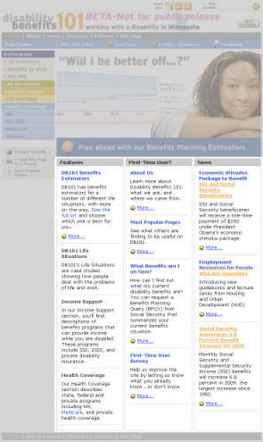
Major Findings
Most participants could not make effective use of the Home Page to effectively orient themselves to the website’s purpose and offering
  Users initially ignored large portions of the Home Page, and began their exploration from the content area below the Center Graphic
  Because the main site offering was not systematically presented in this area, many initially missed key content and/or failed to form a clear idea of the structure of the site
  Most did not pay attention to the Center Graphic, which appeared similar to an advertisement
  Many chose not to use the Left Navigation, because this was seen as secondary navigation
Users ignored grey areas
10

Slide 11
Major Findings
Many participants found it hard to read much of the website content.
  Most content was written in an undifferentiated prose style that is difficult to read on the web
  Some content pages were overly long
  Text in some areas was presented in reverse type, which is more difficult to read
  Headings, font sizes and alignment often varied unsystematically, increasing the effort required to process text
11

Slide 12
Major Recommendations
Create separate experiences for consumers and professionals: a basic version geared towards consumers and an advanced version targeted to professional users
  Different benefits content
  Different Estimator experiences
For consumers, design a simplified overview of Benefits to Work Estimator results, offering a link for secondary access to more advanced tables and charts
Streamline the Benefits to Work Estimator process by combining, collapsing and eliminating screens where possible
Redesign the Home Page to take better advantage of the main content area and reduce focus on the Center Graphic
Ensure the website meets consumer users at their level by avoiding terms this group does not understand
Reformat and reduce content for better web readability
Break up some longer content pages into smaller, manageable content pages
12

Slide 13
Detailed Findings
➔ Impressions of the Website
Finding and Using Benefits Content
Using the Benefits to Work Estimator - Consumers
Using the Benefits to Work Estimator - Professionals
Using the MA-EPD Estimator
Website Navigation
13
Notes:
13

Slide 14
Impressions of the Website
Consumers were asked to complete the following scenario:
“Imagine that your case worker told you about a new website called Disability Benefits 101 that provides information about disability benefits. You decided to check it out to see what information the website provides about benefits.
Starting from here, please show me what interesting information you find on the site. Feel free to explore the site to see what information you might find that may be of interest to you.”
Professionals were asked to complete the following scenario:
“Imagine that you’ve been informed by a colleague about a new website called Disability Benefits 101 that provides information about disability benefits. You decided to check it out to see what information the website provides about benefits.
Starting from here, please show me what interesting information you find on the site. Feel free to explore the site to see what information you might find that may be of interest to you.”
14

Slide 15
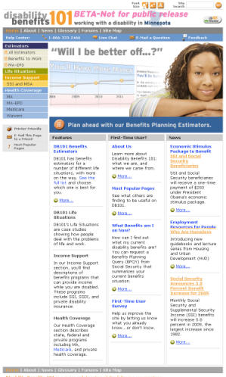
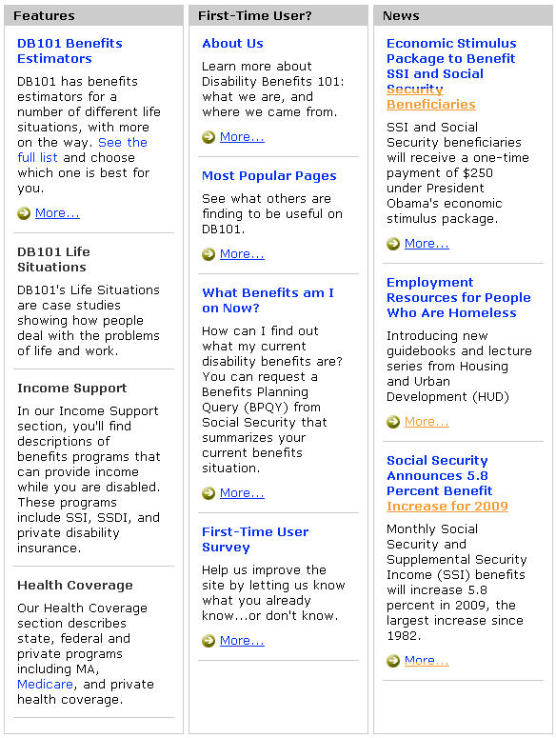
Impressions of the Website: Consumers
Most consumer participants initially explored the content found underneath the image on the Home Page and expected to find access to most of the content through this area.
Most participants ignored the Top Navigation, Left Navigation, and the graphic in the center of the page
Many participants were drawn to the headlines in the center of the page that alluded to information about additional benefits (such as “Economic Stimulus Package to Benefit SSI and Social Security Beneficiaries” or “Income Support”)
Few participants recognized the significance of the placement of content into three columns or noticed the column headings that provided information about this content structure
Few participants accessed additional content using the links labeled “More…”, instead preferring to access content through headings (such as “DB 101 Benefits Estimators” or “About Us”)
15
Notes:
15

Slide 16
Impressions of the Website: Consumers (cont.)
The Home Page did not effectively communicate the purpose and audience of the website to most consumer participants.
Consumer participants generally went to content pages accessible from the main content area or the About Us Page to find this basic information
None of the participants got this information from the “working with a disability in Minnesota” text at the top of the page or the image at the center of the page
16
Notes:
16

Slide 17
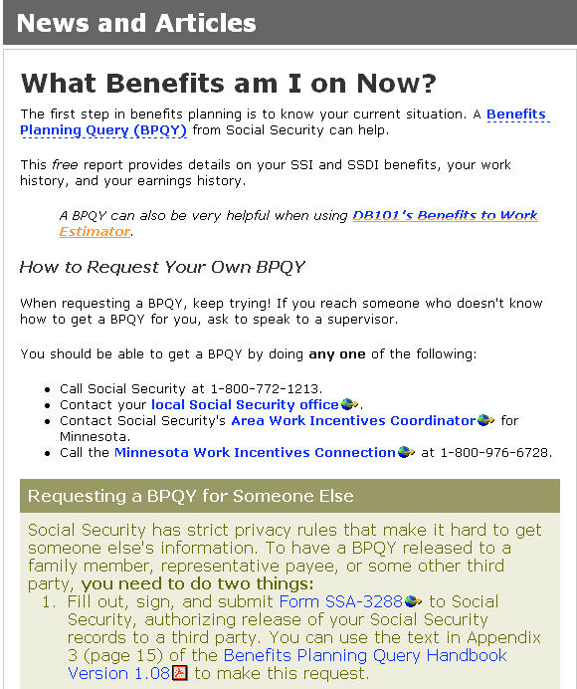
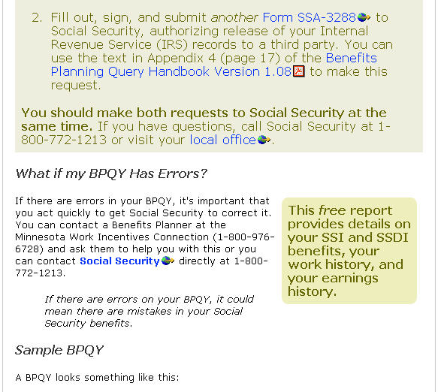
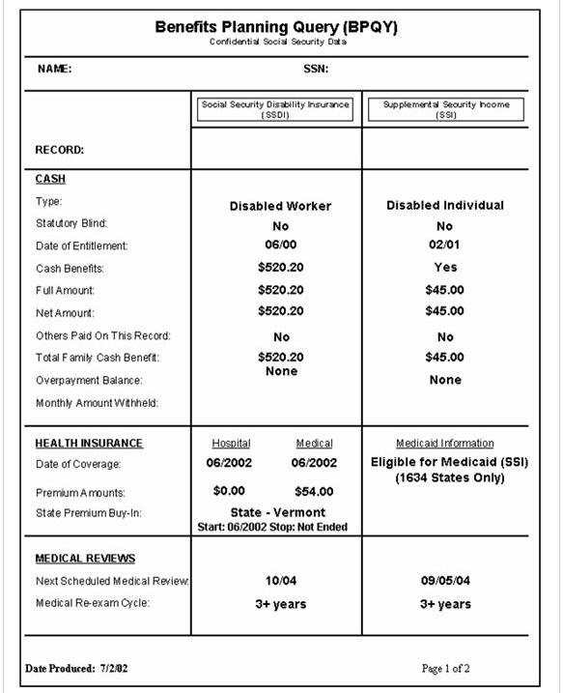
Impressions of the Website: Consumers (cont.)
Some consumer participants explored content pages to learn more about the website, but they often found this content hard to understand.
When consumers read many of these pages, they were confused by the terminology presented to them (such as “BPQY” and the example BPQY on the What Benefits am I on Now Page)
The news article labeled “Economic Stimulus Package to Benefit SSI and Social Security Beneficiaries” was an exception to this finding, because it provided an overview that consumer participants could understand
“I don’t think they are giving me enough information to understand.”
17
Notes:
17

Slide 18
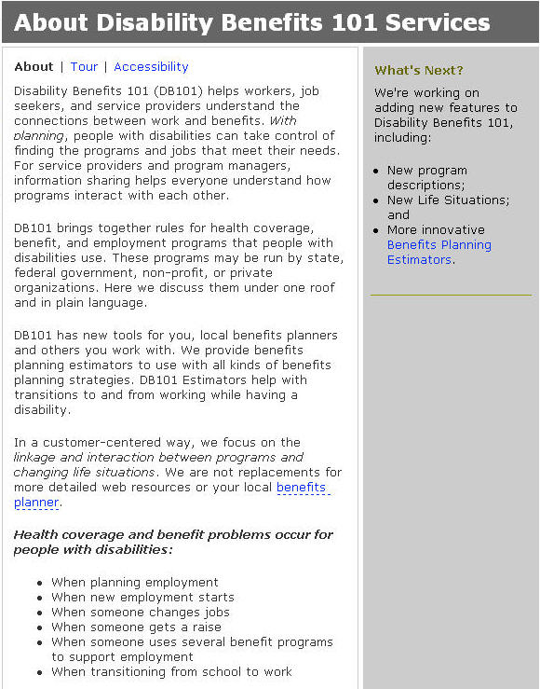
Impressions of the Website: Consumers (cont.)
A couple of consumer participants expected to find information about the purpose and audience of the website on the About Us Page, but found it difficult to locate this information.
The readability of the text on this page was possibly hampered by the amount and length of the text
One participant could not find information describing the audience of the website even though this information was located in the first sentence on this page
18
Notes:
18

Slide 19

Impressions of the Website: Consumers (cont.)
The default font size worked well for most consumers, but a few with vision problems successfully used the Font Size Buttons.
When asked to find this functionality, participants easily found these buttons at the top of the page
Participants were pleasantly surprised to discover this functionality, because they were accustomed to changing font size through the browser or operating system
Because these links are not found in all areas of the website, one participant had to exit an estimator while she was in the middle of her work so she could use this functionality
19
Notes:
19

Slide 20
Impressions of the Website: Professionals
For the most part professional participants interacted with the Home Page in a manner similar to the consumer participants, but they had little difficulty understanding the content they explored.
Most professional participants initially explored the main content area underneath the picture at the top of the Home Page
Unlike consumer participants, some professional participants also explored the links available through the Left Navigation; they may have been more comfortable with the words used in this area of the page
Participants were more familiar with terminology used on the Home Page ( such as “MA-EPD” and “Medicare”)
When exploring secondary content pages in more detail, professional participants were generally able to comprehend the content on these pages
20
Notes:
20

Slide 21
Recommendations
Recommendations: Impressions of the Website
Goal: Communicate the purpose of the website more effectively Include a simple, concise and direct statement explaining the purpose and intended audience of the website. Place it at the top of the main body of the Home Page. Reformat the information that is currently located at the top of the About Us Page to improve scannability. Use paragraph headings to telegraph section content, and bulleted lists where possible.
2. Goal: Make more effective use of the Home Page to showcase site content Reduce the size and prominence of the center image Do not rely on center image for navigation Reallocate the center of the page to showcasing main content sections: Estimators, Life Situations, Income Support and Health Coverage Treat news and first-time user guidance as secondary modules
Goal: Streamline navigation Keep the Font Size functionality Place the Font Size Buttons on every page of the website
21
Notes:
21

Slide 22
Recommendations
Recommendations: Impressions of the Website (cont.)
Goal: Improve the readability of Home Page content Rework gray column header treatment, providing clearer separation from the main image area In each column, reformat the content for greater scannability: consider replacing paragraphs of text with lists of links Move “More” links closer to the corresponding sections
Goal: Avoid confusing consumers with unfamiliar terminology Avoid use of benefit terms and abbreviations in home page links When benefit terms are used in content, provide a way for the consumer to easily find information about unfamiliar terms
Goal: Improve overall readability Reformat content to take advantage of web content formatting standards: divide content into short paragraphs, use separate section headings, use bulleted lists and eliminate excess words
22
Notes:
22

Slide 23
Detailed Findings
Impressions of the Website
➔ Finding and Using Benefits Content
Using the Benefits to Work Estimator - Consumers
Using the Benefits to Work Estimator - Professionals
Using the MA-EPD Estimator
Website Navigation
23
Notes:
23

Slide 24
Finding and Using Benefits Content
Professionals only were asked to complete the following scenario:
“Please pretend that now that you’ve taken a look at the website, you’d like to see if the website can provide you with more information about some questions you have about benefits. Use the site to answer the following question:”
Participants were asked to answer one or more of the following questions:
“What are the eligibility rules for MA-EPD?”
“What is SSI?”
“How does someone apply for Social Security?”
“What is this year’s Federal Benefit Rate for SSI?”
“What is Medicare Part D?”
“What is a Donut Hole?”
24

Slide 25

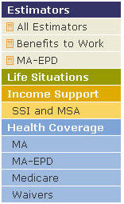
Finding and Using Benefits Content: Professionals
Most professional participants had little trouble finding information on specific benefit programs through the Left Navigation.
Most professional participants used the Left Navigation as a starting point to answer questions about benefits
Participants in this group understood the terms used for benefit categories in the Left Navigation
Participants may have been drawn to these links because the tasks (such as “What are the eligibility rules for MA-EPD?”) may have focused them on terms used in this area of the Home Page
25
Notes:
25

Slide 26
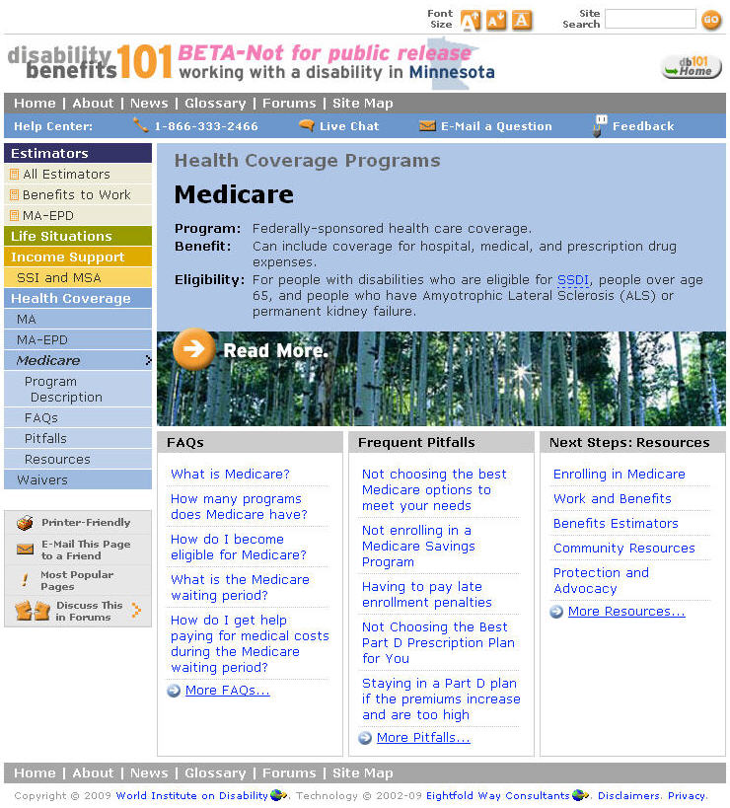
Finding and Using Benefits Content: Professionals (cont.)
Most professional participants ignored the top section of content introductory pages and instead used the area at the bottom or the Left Navigation to access benefit details.
Many participants ignored the content found in top section of the page
None of the participants used the “Read More” link in the center of the page, perhaps because the image appeared to be used for decoration, the link label was ambiguous, and the design of the link made it look like a section heading
After examining the content found at the bottom of the page, participants usually went to the FAQs Link in the Left Navigation or the bottom of the page to access the FAQs
26
Notes:
26

Slide 27
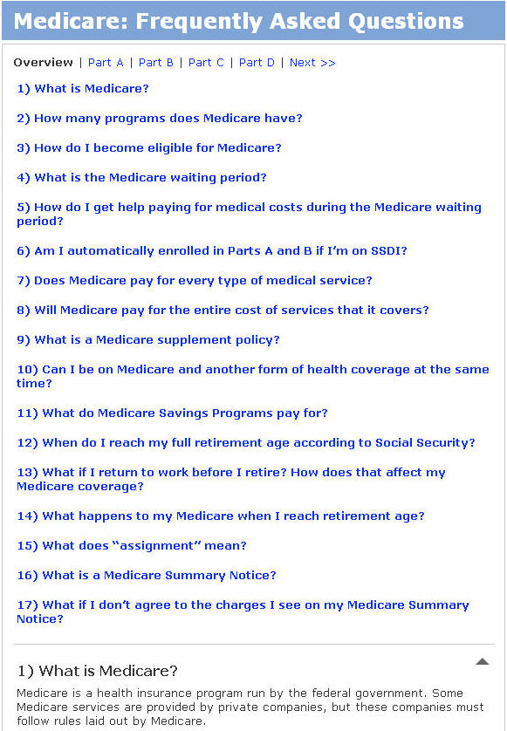
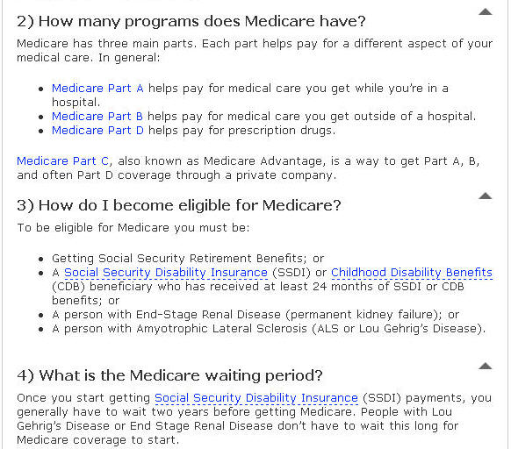
Finding and Using Benefits Content: Professionals (cont.)
Most professional participants could answer questions using the information provided in the FAQ pages.
Participants often searched the question headings of the FAQ page to find the target information; information that could not be located this way was often difficult to find (such as “What is a donut hole?”)
Professional participants had little trouble understanding answers provided to FAQ questions
Most participants did not use the long list of anchor links at the beginning of the page nor the arrow links at the bottom of each question section, making this page difficult to navigate
27
Notes:
27

Slide 28
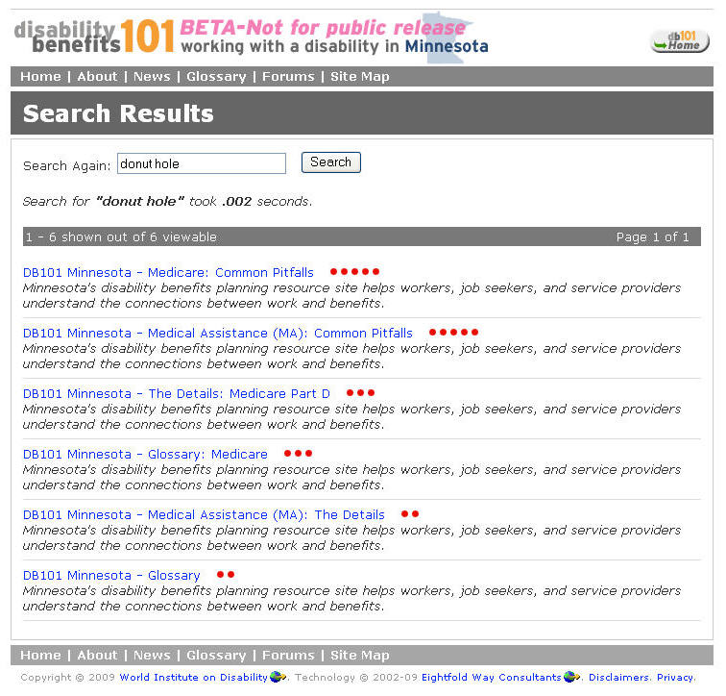
Finding and Using Benefits Content: Professionals (cont.)
Professional participants had problems finding the right target within the search results.
Participants had little trouble locating search in the upper right corner of the website
Participants looked for the search term in the results (such as “donut hole”) to help them determine what link to click on, but the term was not present
Because participants understood the five star icons and the ranking order of results, they assumed the result could be found at the top of the list
Participants clicked on the first result, but were uncertain if this was the correct action to take
28
Notes:
28

Slide 29
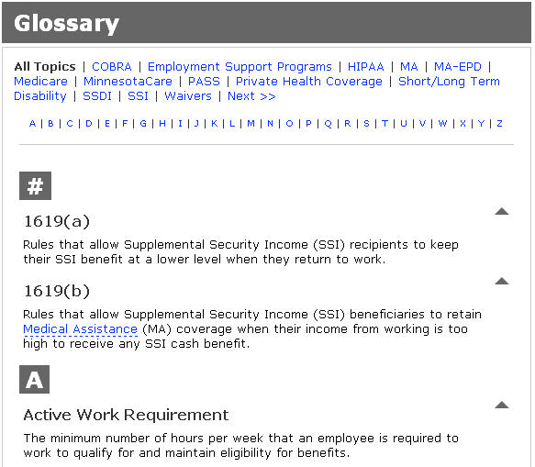
Finding and Using Benefits Content: Professionals (cont.)
Professional participants successfully found information on the Glossary Page, but failed to notice the hyperlinks at top of the page.
Some professional participants who could not find information about terms in the FAQ pages chose to search for these terms in the Glossary Page
Most professional participants did not use the hyperlinks at the top of the Glossary Page until prompted to do so; use of these links was understood when prompted
Consumer participants used the Glossary Page in a similar manner
29
Notes:
29

Slide 30
Recommendations
Recommendations: Finding and Using Benefits Content
Goal: Make more effective use of Benefits Content landing pages to introduce section content Move the introductory text at the top of the page underneath the photo Reduce the size of the main image Do not use the main image for navigation
Goal: Enhance the readability and navigability of FAQ pages Divide FAQ Pages into a number of shorter pages Retain the current short format of each question and answer, which proved effective Use words rather than icons to surface “go to top” functionality
30
Notes:
30

Slide 31
Recommendations
Recommendations: Finding and Using Benefits Content (cont.)
Goal: Improve ability to select relevant search results For each result, show sample text containing search terms, highlighting those terms Retain relevance icons, which proved effective Preserve overall information formatting and table structure
Goal: Improve navigability of Glossary Use paging as a navigation structure through the glossary terms (similar to the search results pages) Support filtering of glossary content (both alphabetical and by program) Allow the glossary terms to appear in website search results Consider combining the glossary terms with the larger help content
31
Notes:
31

Slide 32
Detailed Findings
Impressions of the Website
Finding and Using Benefits Content
➔ Using the Benefits to Work Estimator - Consumers
Using the Benefits to Work Estimator - Professionals
Using the MA-EPD Estimator
Website Navigation
32
Notes:
32

Slide 33
Using Benefits to Work Estimator: Locating Estimator
Consumers were asked to complete the following scenario:
“Please pretend that you currently do not have a job, but you feel you are able to take a part time position. Where do you think you might go on this website to determine how your disability payments and healthcare coverage may change if you take on a part time job?”
33

Slide 34
Using Benefits to Work Estimator: Locating Estimator (cont.)
From the Home Page, most consumer participants were slow to find the Benefits to Work Estimator.
None of the participants accessed this estimator through the image in the center of the page, perhaps because this area was seen as an inactive image or advertisement
Few participants accessed this estimator through the Left Navigation, because the labels for the “Estimators” and “Benefits to Work” links were sometimes misinterpreted; this may have led to some confusion over the target for these links
Most participants comprehended the description found under “DB101 Benefits Estimators” and accessed the estimator from this area
34
Notes:
34

Slide 35
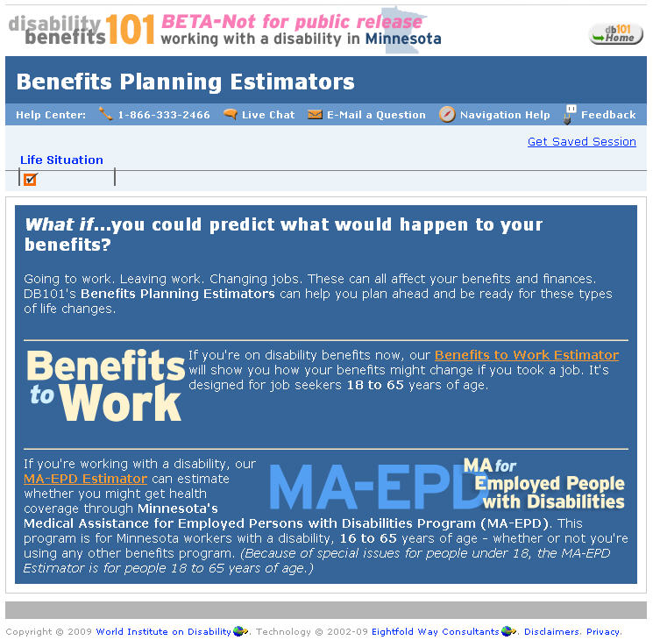
Using Benefits to Work Estimator: Locating Estimator (cont.)
On the All Estimators Page, consumers found it difficult to process the information and to access the Benefits to Work Estimator.
Some participants initially believed that there were three estimators accessible from this page, instead of two
A couple of participants were initially unsure how to access an estimator, but eventually found a link that took them to the correct location
The inconsistent layout of text, the use of light text on a dark background, and the three defined rows on the page may have contributed to the challenges consumers faced when using this page
35
Notes:
35

Slide 36
Using Benefits to Work Estimator: Completing Estimator
Consumers were asked to complete the following scenario:
“Please imagine that you are considering finding a part time job at Arby’s that pays $7/hr. Pretend that you’d like to work 18 hours a week in this job and you are interested in finding out how taking this job will impact your disability benefits. Use the Benefits to Work Estimator to see how your benefits may change if you get this part time job.”
This group of participants was asked to use information about their benefits that they had brought with them to the session.
36

Slide 37
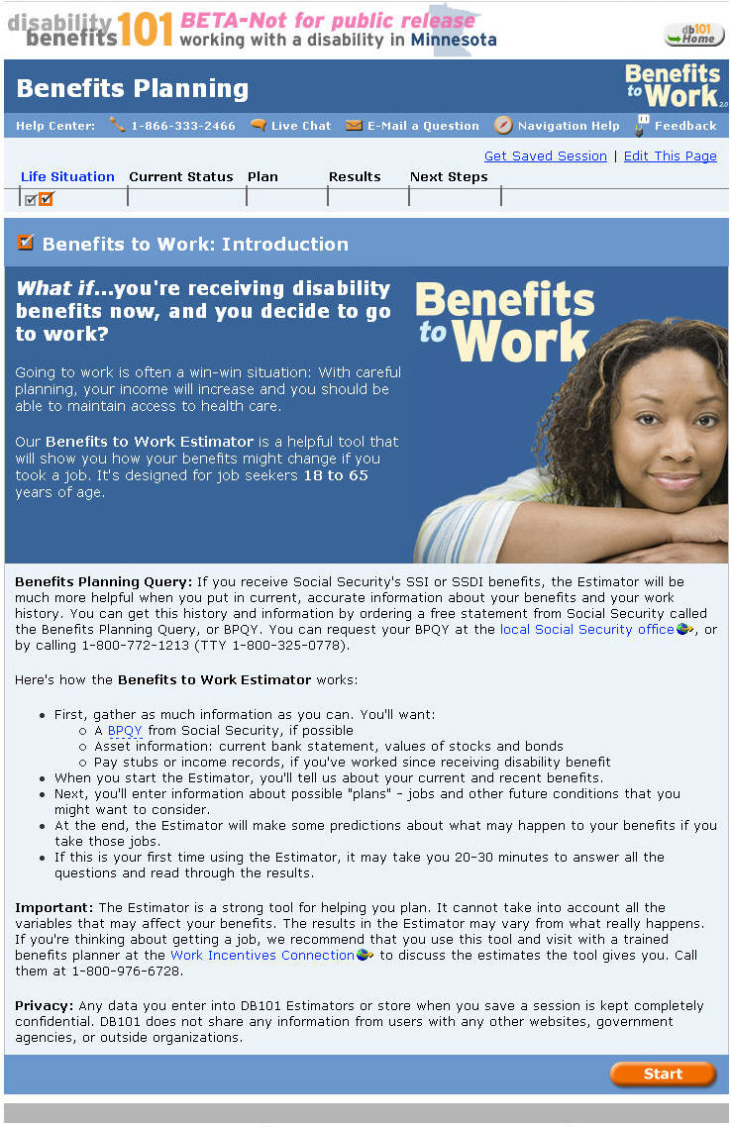
Using Benefits to Work Estimator: Completing Estimator (cont.)
Consumers had difficulty using the Benefits to Work Introductory Page to learn more about the purpose of this tool.
The top area of content that contained the purpose was often ignored by participants, possibly because of the use of white text on a dark blue background
Consumer participants found the content on this page to be hard to read, because of the large amount of text and the format of some of the text in paragraphs
One consumer believed that the estimator was a live person she could meet with; this misunderstanding was not cleared up by the content found on this page
  “There’s just too much information. I don’t want to read it.”
37
Notes:
37

Slide 38
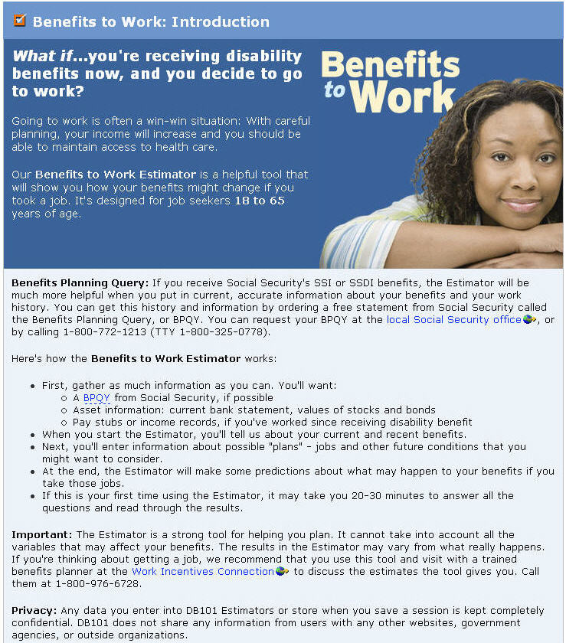
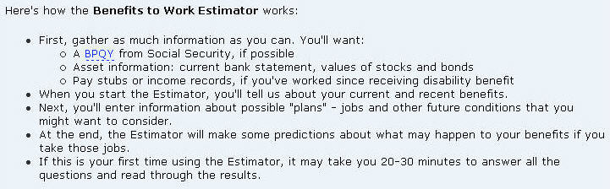
Using Benefits to Work Estimator: Completing Estimator (cont.)
The Benefits to Work Introductory Page did not successfully communicate preliminary requirements and time considerations.
Many participants scanned the content on this page and read only the bulleted content section in the middle of the page
One participant read the “BPQY” information and believed she needed to contact Social Security before proceeding with the Benefits to Work Estimator
Most participants did not see the time estimate for completing the tool
38
Notes:
38

Slide 39
Using Benefits to Work Estimator: Completing Estimator (cont.)
Some participants did not understand how to begin using the estimator once arriving at the initial page, because the Start Button was two screens below the fold.
Participants did not easily find the Start Button at the bottom of the page and often scrolled up and down the page before finding this button
The location of the Start Button far below the fold may have made it less obvious that the estimator was a calculator
Page fold 1
Start button
Page fold 2
39
Notes:
39

Slide 40
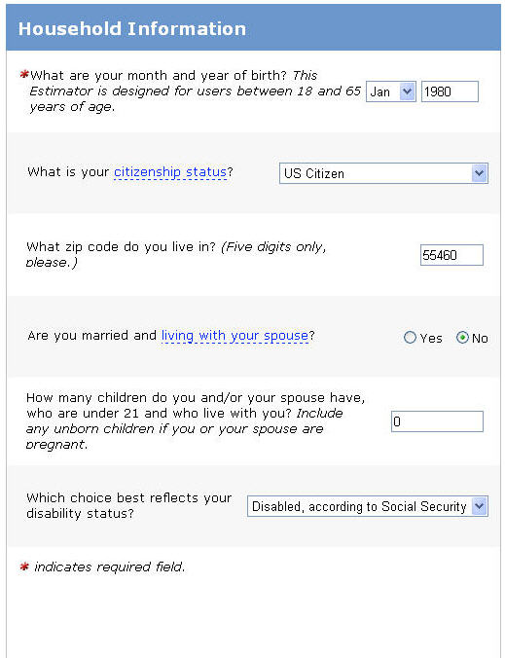
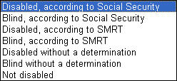
Using Benefits to Work Estimator: Completing Estimator (cont.)
Most consumers completed the Household Information Page with little difficulty.
Most participants could answer the birth date question, but were unsure of the correct birth year format
The “SMRT” abbreviation used in the Disability Status Drop-Down List was confusing to most participants
Because participants did not initially see the “* indicates required field” text at the bottom of the page, many participants double-checked the form to ensure all of the required fields were completed
“How come it doesn’t say [the format]?”
40
Notes:
40

Slide 41
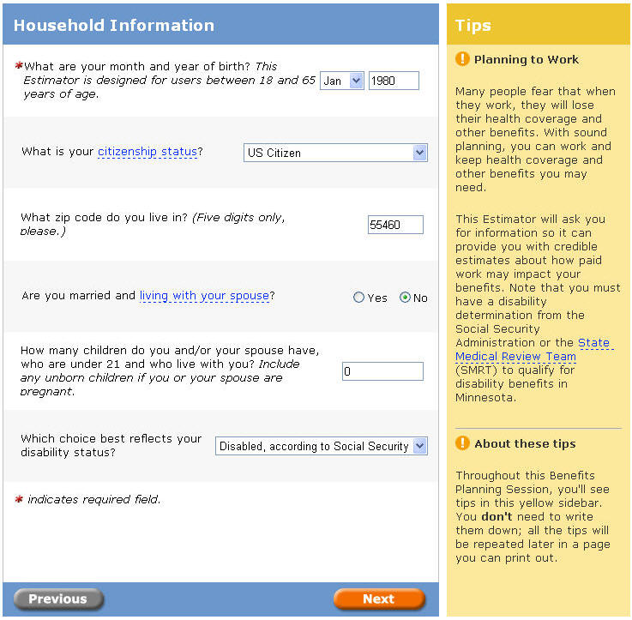
Using Benefits to Work Estimator: Completing Estimator (cont.)
Consumers were slow to notice the Tips Section on the right side of the pages.
Participants noted that they wanted to focus on filling out the form and chose to ignore anything else on the page
The Tips Section was placed in an area of the page usually reserved for advertisements on web pages, possibly adding to ignorance of this area
41
Notes:
41

Slide 42
Using Benefits to Work Estimator: Completing Estimator (cont.)
Most consumer participants did not clearly understand the purpose of the Tips section.
Many participants believed the Tips Section contained help content that was directly related to form on the page and were sometimes confused when the Tips Section did not provide help on a question in the form
Most participants did not notice that the Tips Section also contained some general information about disability benefits that did not directly relate to the content found in the Form Section of the page
42
Notes:
42

Slide 43
Using Benefits to Work Estimator: Completing Estimator (cont.)
When looking for help with term definitions, some consumers initially struggled to discover the function of the Glossary Term Links, but most soon found value in this functionality.
Most participants used these links as information to help them scan the questions in the form
Some participants did not expect to find links embedded within form questions and often did not discover the Glossary Term Links until prompted
Once participants learned the Glossary Term Link functionality, they found the ability to access help within the context of a question to be valuable
43
Notes:
43

Slide 44
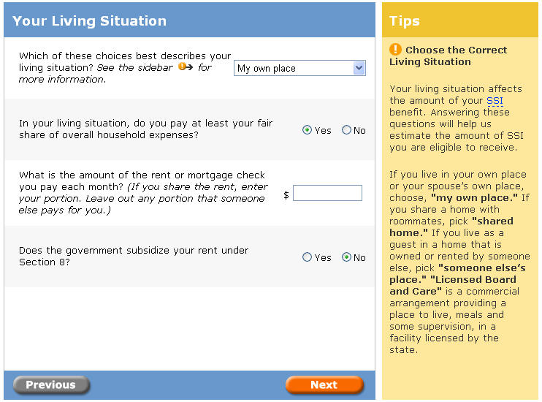

Using Benefits to Work Estimator: Completing Estimator (cont.)
Some consumer participants had some difficulty using the form on the Your Living Situation Page.
Some participants were unsure of the meanings of some options in the first drop-down list (such as “Shared home (roommates)”); these participants either used the Tips Section or assumed what answer was right was for their situation
Some participants found it difficult to understand question phrasing
  Phrases included: “fair share of overall household expenses”, “subsidize your rent under Section 8”
44
Notes:
44

Slide 45
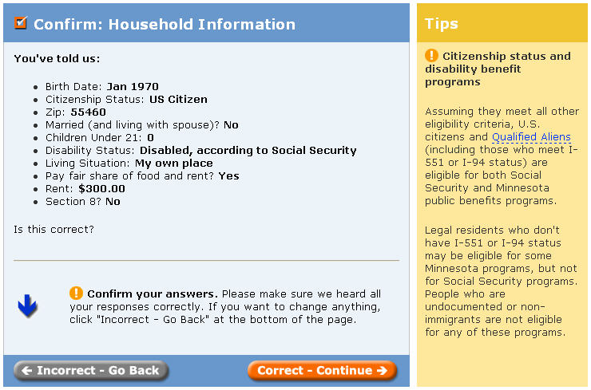
Using Benefits to Work Estimator: Completing Estimator (cont.)
All of the consumer participants understood the confirmation pages and made sure the values shown on these pages were accurate.
When participants found an error, they corrected the error before proceeding with the process
“It’s nice to stop and look back.”
45
Notes:
45

Slide 46
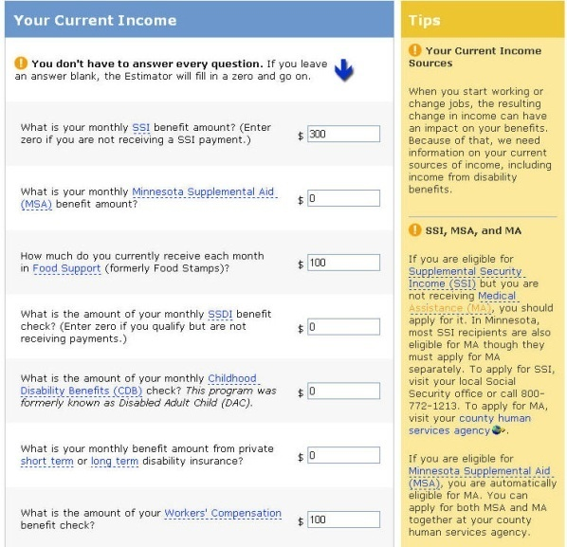
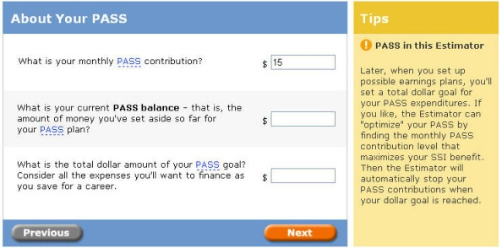

Using Benefits to Work Estimator: Completing Estimator (cont.)
When participants went back a screen to correct information previously entered, they were disappointed to discover their data sometimes disappeared.
Step One
Step Two
Step Three
46
Notes:
46

Slide 47
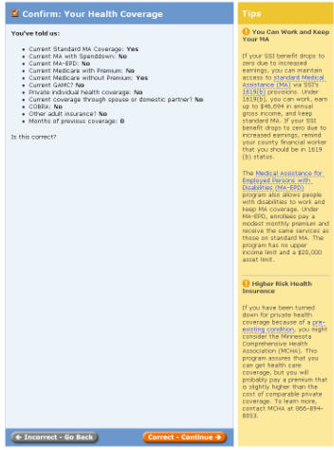
Using Benefits to Work Estimator: Completing Estimator (cont.)
Many consumer participants were confused about how to make a correction in the estimator.
The “Incorrect - Go Back” Button was often not used by participants to make corrections, perhaps it was not seen due to the grey button color and the location of this button at the bottom of pages
Many participants expected to use a browser back button and did not think to use a back button on the website.
47
Notes:
47

Slide 48
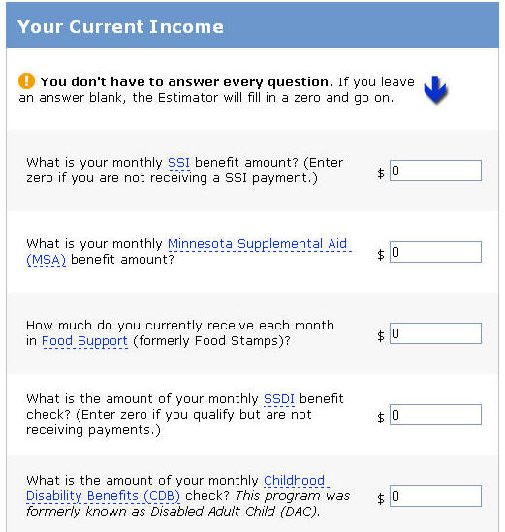
Using Benefits to Work Estimator: Completing Estimator (cont.)
Most consumer participants decided to complete every form element on the Your Current Income Page, even though they might have understood that an item could be left blank.
Most participants did not read the text at the top of the first form page that said they could leave these items blank
Even if the participants read this text, they still entered ‘0’ in the text boxes on this page “to be safe”
Participants also used these zeroes like checkmarks marking their progress through forms
48
Notes:
48

Slide 49
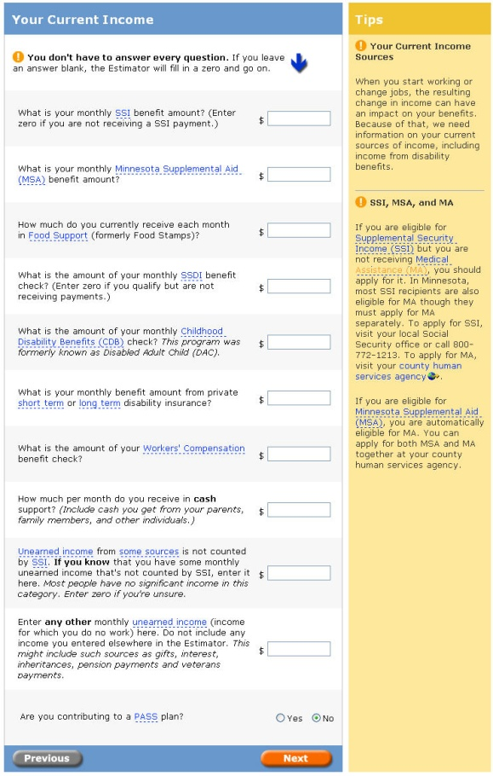


Using Benefits to Work Estimator: Completing Estimator (cont.)
Consumer participants often had a tenuous grasp of their benefits, which made it more difficult for them to understand terms used on the Your Current Income Page.
Some consumer participants were confused about the difference of similar terms
  Similar terms included: “SSI” and “SSDI”, “MA with a spenddown” and “standard MA”, “current Medicare with premium” and “current Medicare without premium”
The help content did not help participants make a distinction between similar terms
Some consumer participants were familiar with older terms for their benefits that were not found on this page
  Older terms included: “PA”, “RSDI”, “General Assistance”
“They are not spelling it out for me.”
49
Notes:
49

Slide 50


Using Benefits to Work Estimator: Completing Estimator (cont.)
The PASS term shown on the Your Current Income Page was unfamiliar to many consumer participants and caused some to struggle when completing the estimator.
Some consumers were very interested to learn if they qualified for PASS and they spent a lot of time trying to learn about this benefit
The Tips Section or Glossary Term Links did not provide enough information to teach these participants about this benefit
50
Notes:
50

Slide 51
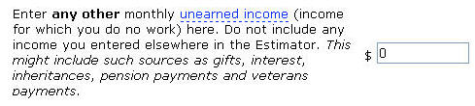
Using Benefits to Work Estimator: Completing Estimator (cont.)
On the Your Current Income Page, many consumer participants found it challenging to answer questions because they were confusing.
Many terms and phrases were complex and not clearly explained in the help content
  Complex terms included: “unearned income”, “cash support”
Help text was sometimes embedded in questions, which made these questions more difficult to understand
51
Notes:
51

Slide 52
Using Benefits to Work Estimator: Completing Estimator (cont.)
Some consumer participants wanted to tab between the controls on forms to expedite data entry.
When participants used the Tab Button , it often highlighted the Glossary Term Link in the question and then the associated text box
This tab order functionality design was undesirable for participants who had this preference
1
2
52
Notes:
52

Slide 53
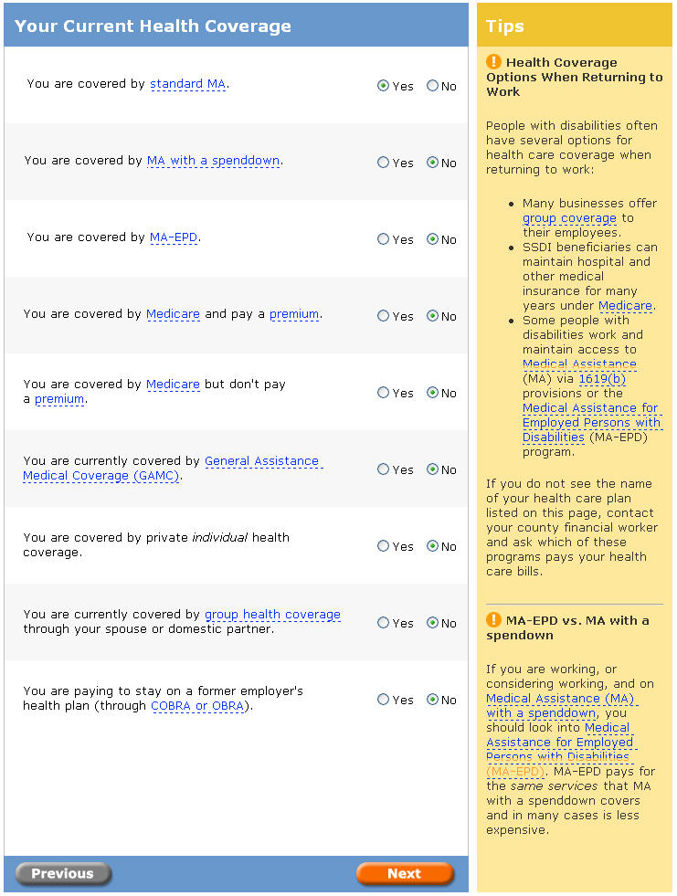
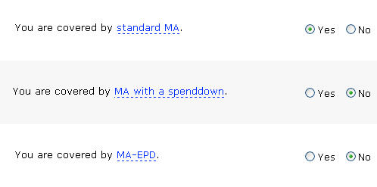
Using Benefits to Work Estimator: Completing Estimator (cont.)
Many consumer participants had difficulty with the terms presented to them on the Your Current Health Coverage Page.
Abbreviations and terms about benefits were confusing to many participants
  Terms included: “standard MA”, “MA with a spenddown”, “MA-EPD”, “General Assistance Medical Coverage (GAMC)”
Consumer participants often had cursory knowledge of their benefits, which further added to the confusion over these terms
53
Notes:
53

Slide 54
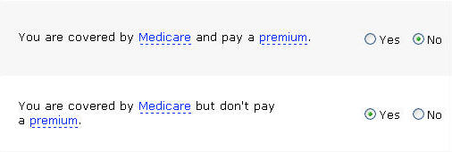
Using Benefits to Work Estimator: Completing Estimator (cont.)
Compound questions on the Your Current Health Coverage Page that appeared to describe mutually exclusive circumstances were confusing to most consumer participants.
Many participants were unsure how the questions were related
  Questions included: “You are covered by Medicare and pay a premium.” and “You are covered by Medicare but don’t pay a premium.”, “You are covered by standard MA” and “You are covered by MA with a spenddown”
The compound logic used in these questions made them more difficult for participants to read and answer
54
Notes:
54

Slide 55
Using Benefits to Work Estimator: Completing Estimator (cont.)
Many consumer participants did not readily know how to proceed on the Your Health Coverage Confirmation Page.
The “Incorrect – Go Back” and “Correct – Continue” Buttons are below the page fold, perhaps making these buttons hard to find
Some participants stated that they thought it was odd that the “Incorrect - Go Back” and “Correct – Continue” Buttons were far from the “Is this correct?” question in the blue area of the page
Page fold
55
Notes:
55

Slide 56
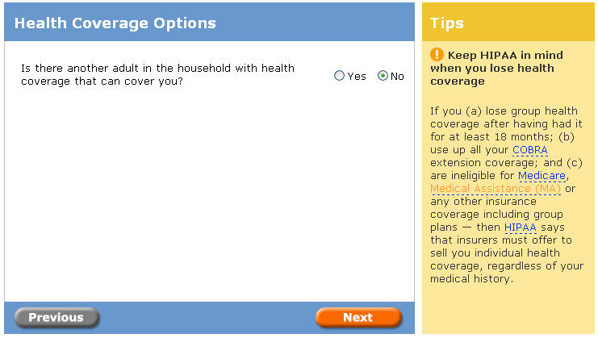
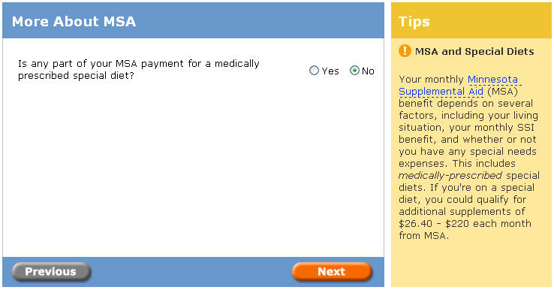
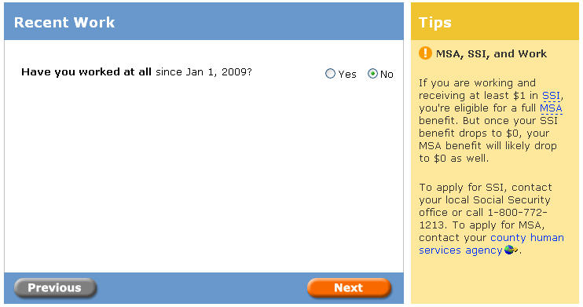
Using Benefits to Work Estimator: Completing Estimator (cont.)
Use of a single question on individual pages drew a negative reaction from some participants, because they felt these pages were inefficient.
Although these pages were easy to complete, participants thought these pages added more steps and made the process seem longer
56
Notes:
56

Slide 57
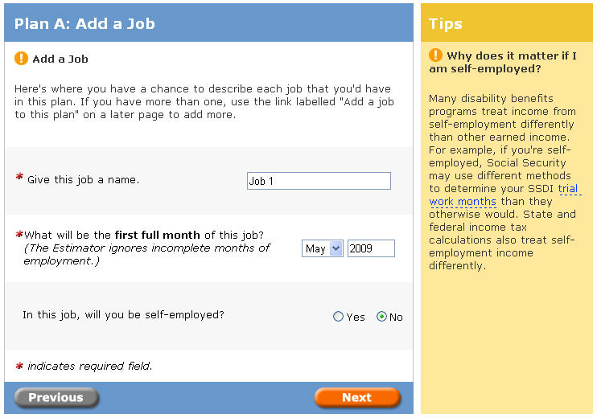
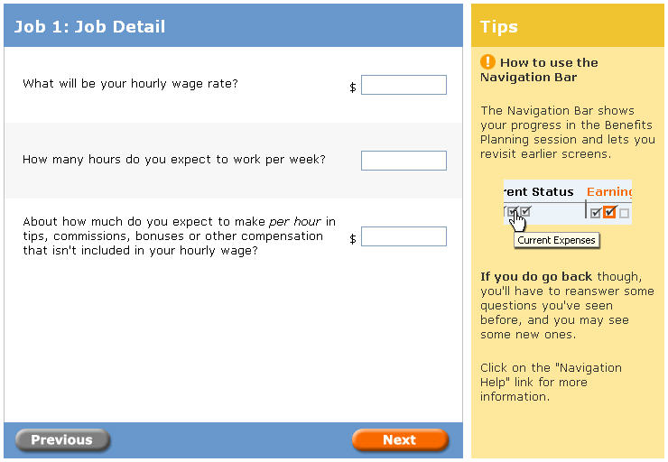
Using Benefits to Work Estimator: Completing Estimator (cont.)
Compared to other areas of the estimator, consumer participants had little difficulty completing information about a single job plan.
Most of the terms used in this part of the estimator were easier for consumer participants to understand
The length of these pages was considerably shorter than the previous sections of the estimator, perhaps making using these pages easier to complete
A couple of terms used in these questions were unclear, but posed little difficulty
  Terms included: “Impairment Related Work Expenses”, “PASS”
“It’s simple and straightforward.”
57
Notes:
57

Slide 58
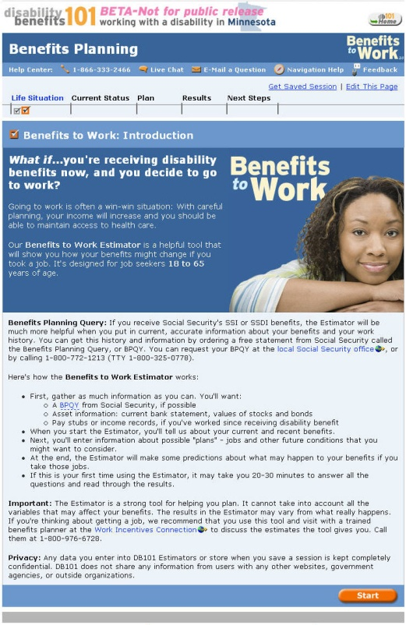
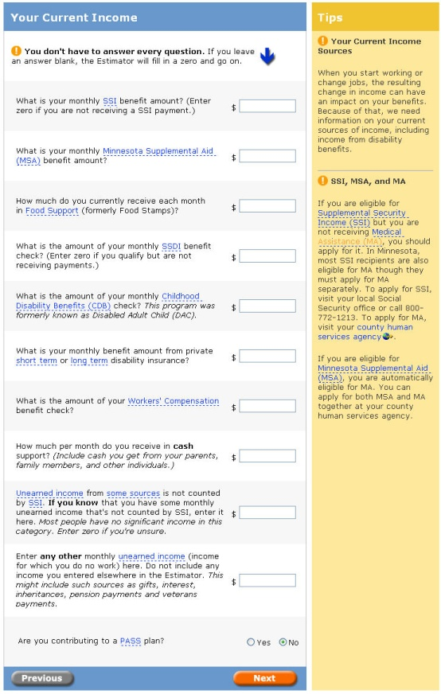
Using Benefits to Work Estimator: Completing Estimator (cont.)
In the middle of the process, many participants remarked that this estimator took a long time to complete.
Some participants found relief when they reached a point were they could enter work information
Some participants stated a preference for having the job information at the beginning of the estimator
Participants saw the job data to be the primary information and the benefits data to be secondary information and wished the process would match this idea
“It’s a lot of questions.”
58

Slide 59
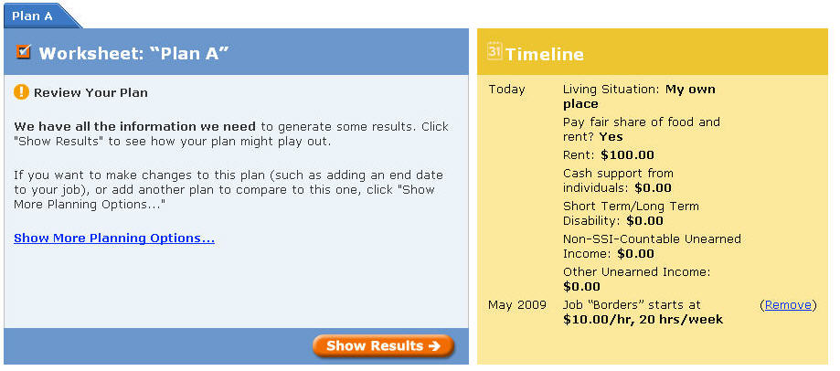
Using Benefits to Work Estimator: Processing Results
Most consumer participants expected to see results on the Plan Worksheet Page and could not understand the content on this page due to this assumption.
Participants had difficulty comprehending the purpose of content found in the left side of this page, because it contained little detailed information about the results
Participants believed the timeline on the right side of the page to be either a timeline of the future or a summary of what was entered in the estimator, both of which were incorrect
Once participants saw the Show Results Button, they proceeded to that page
59
Notes:
59

Slide 60
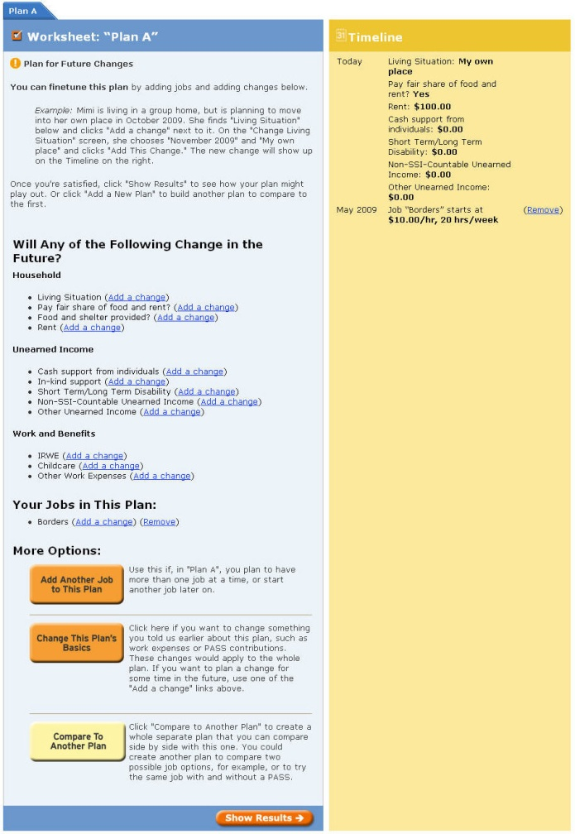
Using Benefits to Work Estimator: Processing Results (cont.)
Changing future information on the expanded version of the Plan Worksheet Page was difficult for participants to comprehend and was unnecessary for most who are entering simple job plan information.
Participants could not comprehend the modification functionality found under “Will Any of the Following Change in the Future?”
The three buttons under “More Options” asked participants to change information they had just entered, which was unexpected
Some participants had a harder time finding the Show Results Button at the bottom of the page, perhaps because of its location at the bottom of this expanded version of this page, its conflicting appearance with the three “More Options” buttons, and the non-standard central location
60
Notes:
60

Slide 61
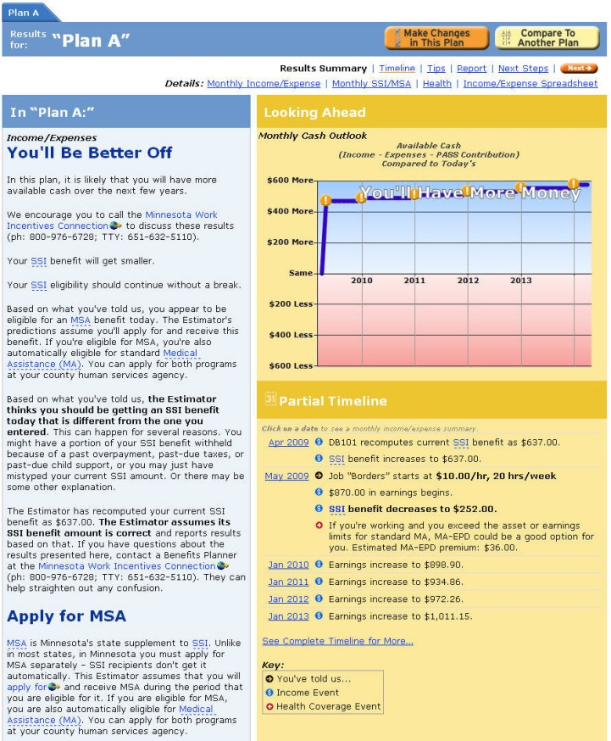
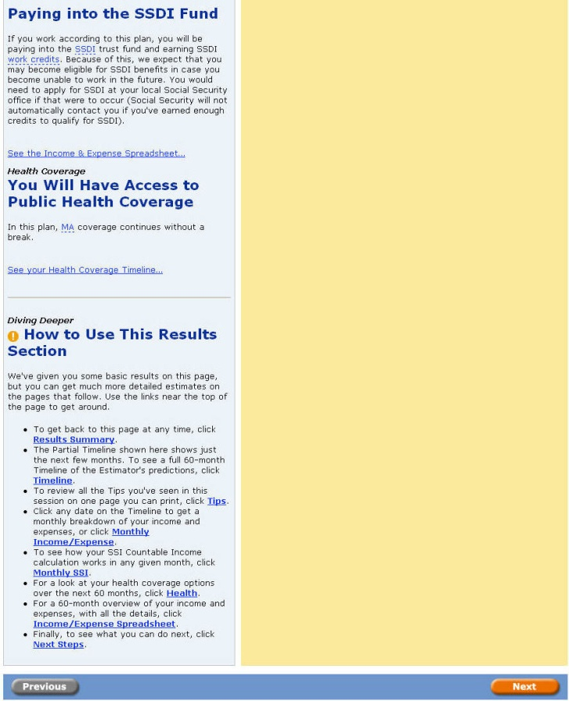
Using Benefits to Work Estimator: Processing Results (cont.)
Upon reviewing the Results Summary, participants could not comprehend the bottom line impact that working would have on their benefits.
Participants explored the text on the left, the graph, and the timeline, but none of this content gave them a complete understanding of their benefits
Participants could conclude from the graph that their earnings would increase over time, but had difficulty learning more about their projected income
“There’s a lot here.”
61
Notes:
61

Slide 62
Using Benefits to Work Estimator: Processing Results (cont.)
On the Results Summary Page, participants had could not confirm that the information they had entered was correct.
Some consumers had entered wrong information in the estimator and could not tell from this page that what they had entered was incorrect
There is no access to a page providing a quick overview of the data entered that would allow them to make corrections
Some participants had an inaccurate understanding of their benefits, which added to their confusion about the information shown

Slide 63
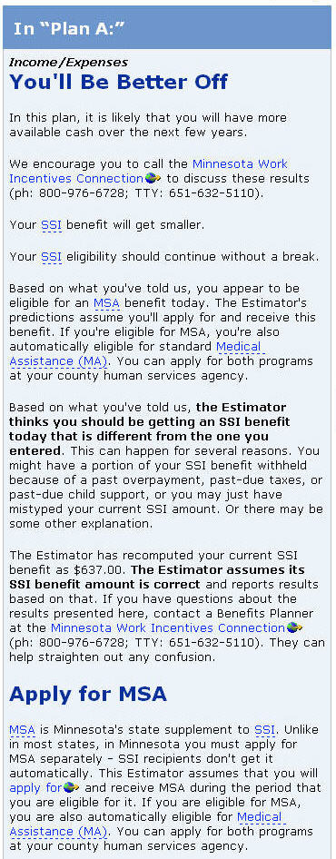
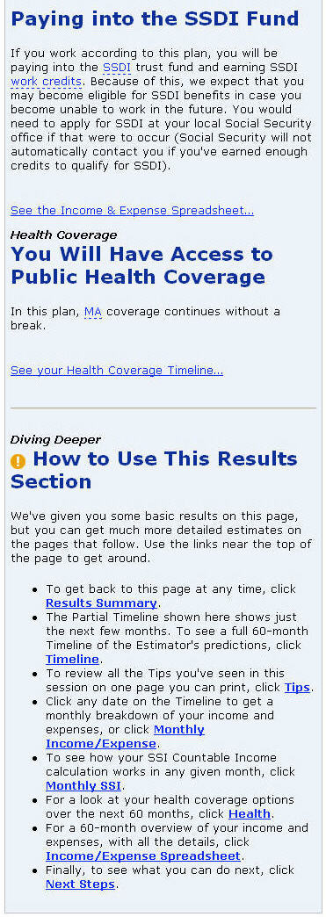
Using Benefits to Work Estimator: Processing Results (cont.)
Consumer participants who used the left side of the Results Summary Page understood the quick summary, but did not understand most of the remaining content in this section.
Participants understood the overview phrase (such as “You’ll Be Better Off”) and content
Some of these participants tried to read the content in this area of the page and became confused about what this information meant to them
The Diving Deeper Section at the bottom of this section of the page was largely ignored by the majority of these participants
63
Notes:
63

Slide 64
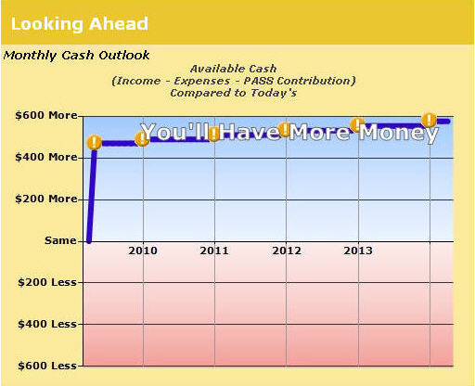
Using Benefits to Work Estimator: Processing Results (cont.)
Many consumer participants understood how to read the graph on the Results Summary Page and were able to get a general overview of projected income from this graph.
The tagline on the graph was quickly noticed and understood by participants
Some participants wanted to see one year instead of the five-year interval shown in the graph
64
Notes:
64

Slide 65
Using Benefits to Work Estimator: Processing Results (cont.)
When participants clicked to explore the orange explanation icons, most became lost and confused when arriving at the Monthly Income/Expense Page.
Many participants noticed these icons and explored them, but some participants had to be prompted to find this information
Not everyone who explored these icons realized they were clickable
The hover functionality was found for these icons, but the hover functionality on the blue line not for intervening months was not noticed
Participants who did clicked on these icons quickly became lost and disoriented when arriving at the Monthly Income/Expense Page
65
Notes:
65

Slide 66
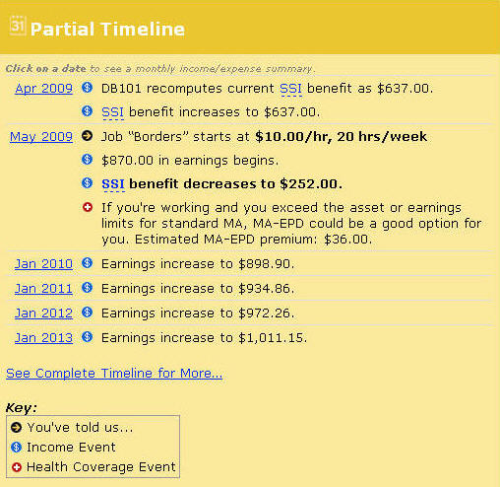
Using Benefits to Work Estimator: Processing Results (cont.)
Consumer participants largely viewed the Partial Time as an overview of benefits and not as timeline on the Results Summary Page.
In glancing at the timeline, some participants focused on areas in bold that indicated that their benefits would decrease, and then ignored most of other benefit information in the timeline
  These participants often drew the conclusion that getting this job would be a bad idea, because their benefits would decrease
In an attempt to find more information, some participants clicked on one of the month links
The icons and key drew little attention
66
Notes:
66

Slide 67
Using Benefits to Work Estimator: Processing Results (cont.)
Participants ignored large portions of the navigation present at the top of the Results Summary.
Most participants did not use the links in the Details section of the navigation until asked by the moderator
Many participants did not use the Timeline, Tips, Report and Next Steps links until prompted
None of the participants used the Back and Next Buttons present in this navigation
Participants may have ignored this navigation because of the location and the visual treatment of this section of the page

Slide 68
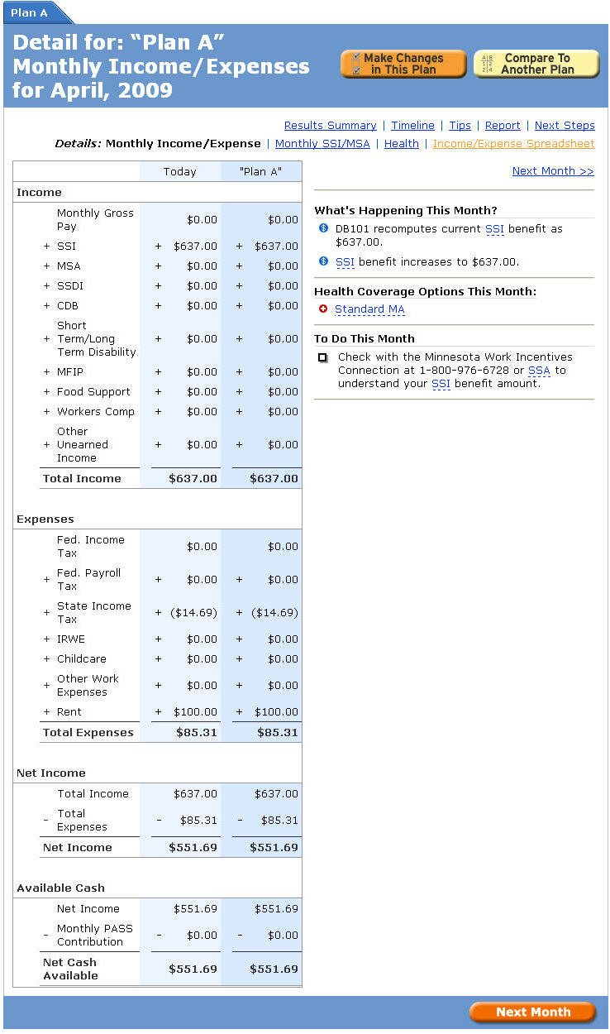
Using Benefits to Work Estimator: Processing Results (cont.)
The Monthly Income/Expense Page overwhelmed and confused most consumer participants.
Participants had difficulty determining the current month and did not understand how to navigate from month to month
The table was difficult for most to interpret and comprehend
The terminology used was confusing and the benefit explanations were lacking, leaving some participants to worry if taking a job would be a good idea
  “It seems scary”
The button at the bottom of the page was largely ignored
“I don’t know…it seems confusing.”
68
Notes:
68

Slide 69
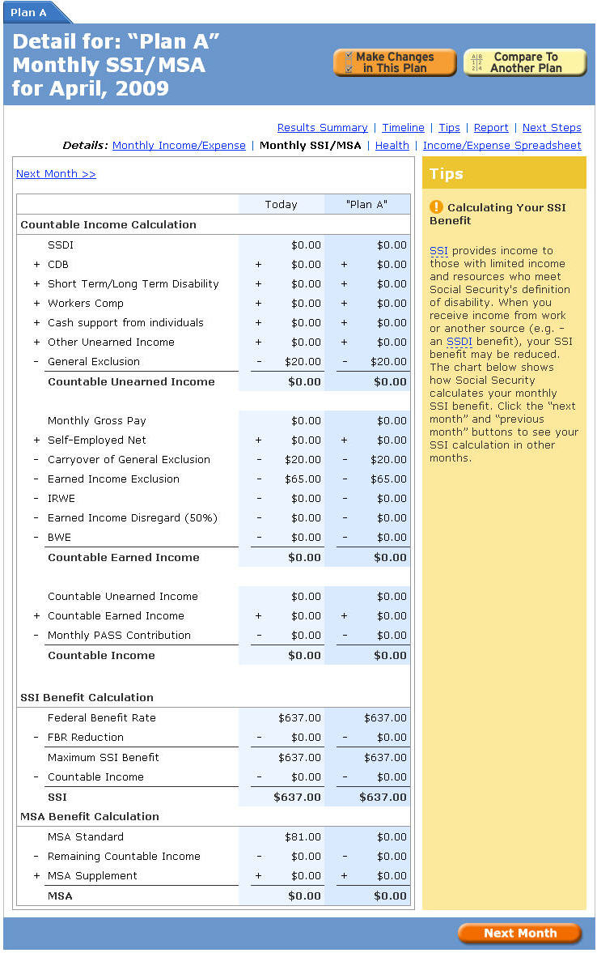
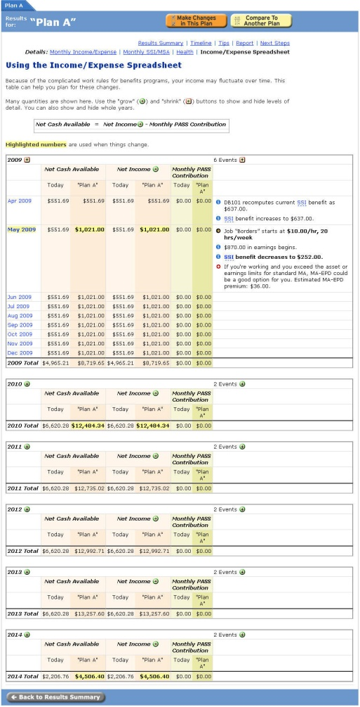
Using Benefits to Work Estimator: Processing Results (cont.)
The Monthly SSA/MSA and Income/Expense Spreadsheet Pages also were extremely confusing for most consumer participants.
Participants could not draw any firm conclusions about how their benefits would change from this information
These pages had many of the same issues noted for the Monthly Income/Expense Page
69
Notes:
69

Slide 70
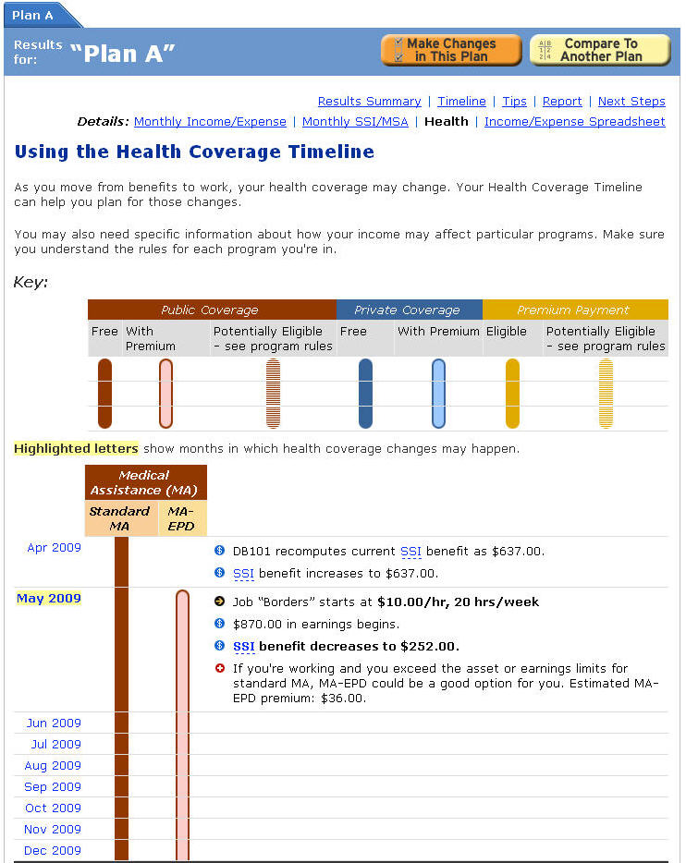
Using Benefits to Work Estimator: Processing Results (cont.)
Consumers could easily comprehend and understand the information on the Health Page.
Participants liked seeing a quick snapshot of how their health benefits may change, since keeping these benefits was very important to them
Participants could understood how to use the key and symbols to read the timeline
A couple of participants remarked that they liked the summary of benefits changes provided at the right of the graph
70
Notes:
70

Slide 71
Using Benefits to Work Estimator: Processing Results (cont.)
Consumers did not notice or use the month links on the Health Page.
Many participants did not click on the month links
When probed, most participants did not understand the meaning of the yellow highlight on month links and did not notice the explanatory text about this highlight
71
Notes:
71

Slide 72
Using the Benefits to Work Estimator: Create Report
Consumers were asked to complete the following scenario:
“Imagine that you would like to keep a record of what you found out about your benefits to share it with your case worker. Attempt to keep a copy of the information about your benefits so you can share it with your case worker.”
72

Slide 73

Using the Benefits to Work Estimator: Create Report (cont.)
Most participants could not find the page that would allow them to download a copy of the results.
Participants had to be prompted to find this functionality in the “Report” section
The term “report” probably does not match most participants’ conceptions of terms for export and print format functionality.
Participants may have expected to find this functionality in a utilities section of the results and not as a separate results page
73
Notes:
73

Slide 74
Using the Benefits to Work Estimator: Save Session
Consumers were asked to complete the following scenario:
“Pretend that now that you’ve found this information about benefits, you’d like to keep a record of this information for future use. Try to keep a record of this information about benefits on the website.”
74

Slide 75


Using the Benefits to Work Estimator: Save Session (cont.)
Generally consumer participants understood the save functionality, but did not expect this functionality to be part of the estimator.
Most participants could find the Save Session Link at the top of the estimator after some prompting by the moderator
Most participants also understood how to retrieve a session using the Get Saved Session Link
We suspect the plan identifiers (such as “Plan A”,”Plan b”) may be difficult for users to distinguish on the Saved Sessions Page
“I didn’t see it before… you brought it to my attention.”
75
Notes:
75

Slide 76
Using the Benefits to Work Estimator: Plan Comparison
Consumers were asked to complete the following scenario:
“Imagine that from what you’ve seen from the first job plan you’ve created, you’ve decided to go ahead and look for a part time job. Pretend that you were just offered a job at Home Depot that pays $7.75/hr and you want to find details how this job will affect your benefits if you decide to work 15 hours a week. Use the Benefits to Work Estimator to find information about how benefits might change if you take this job.”
76

Slide 77


Using the Benefits to Work Estimator: Plan Comparison (cont.)
Consumer participants did not understand how a “plan” was related to a job, which caused them to run into trouble when adding a second job.
Participants generally used the buttons at the top of the Results Summary Page to do this task
The functionality of the Make Changes in This Plan Button was unclear, because many participants did not understand that this would add another job to the current plan
Participants also did not get that the Compare To Another Plan Button would allow them to create a new plan to use for a comparison
Participants did not think it made sense to use Compare To Another Plan Button if there was only one job plan in a session; they believed this button would provide an option to select multiple jobs that had already been entered for a comparison
77
Notes:
77

Slide 78

Using the Benefits to Work Estimator: Plan Comparison (cont.)
While people were able to enter in job information for a second plan, they were not able to effectively compare plans.
Many people did not understand the Results Summary Page well enough to make a good comparison
Participants primarily used two plan lines on the graph to make a comparison and found this insufficient
Participants found it hard to make a comparison using the two plan tabs; participants may have succeeded if this information was presented in a way that would have allowed them to easily compare plan details side-by-side
One participant accidentally deleted both jobs in a plan when attempting to compare jobs, leaving her very confused about the information shown
78
Notes:
78

Slide 79
Detailed Findings
Impressions of the Website
Finding and Using Benefits Content
Using the Benefits to Work Estimator - Consumers
➔ Using the Benefits to Work Estimator - Professionals
Using the MA-EPD Estimator
Website Navigation
79
Notes:
79

Slide 80
Using Benefits to Work Estimator: Locating Estimator
Professional participants were asked to complete the following scenario:
“Please pretend that you have a disabled client Eric who does not have a job, but is ready to take a part time position. He is worried about how getting a job may affect the amount of money he currently receives for his disability. You know that the Disability Benefits 101 website contains information about employment that could be useful in helping you with this discussion with your client. Please show me where you might go on this website to determine how his disability payments may change if he takes a part time job.”
80

Slide 81
Using Benefits to Work Estimator: Locating Estimator (cont.)
Compared to the consumer participants, professional participants had little difficulty locating the Benefits to Work Estimator.
Professionals tended to have less difficulty with the terminology used to access this estimator
Just like the consumer participants, these participants only accessed the estimator through the Left Navigation and the Content Area
81
Notes:
81

Slide 82
Using Benefits to Work Estimator: Completing Estimator
Professional participants were asked to complete the following scenario:
“Please imagine Eric interested in getting a part time job at Arby’s that pays $7/hr and working 18 hours a week. Use the Benefits to Work Estimator to determine how that job will affect his benefits.”
82

Slide 83
Using Benefits to Work Estimator: Completing Estimator (cont.)
Professional participants moved more quickly through the Benefits to Work Estimator, because they had little difficulty understanding terms used in the forms.
These participants relied much less on the help content accessible through the Glossary Term Links and the Tips Sections to understand terms
83
Notes:
83

Slide 84


Using Benefits to Work Estimator: Results (cont.)
Compared to consumer participants, professional participants found the Benefits to Work Estimator results more useful.
Professionals were able to read and understand a lot of the benefits content available on these pages
Issues with navigating the forms and results were common between both participant groups
84
Notes:
84

Slide 85
Using Benefits to Work Estimator: Utilities
Professional participants were asked to complete the following scenarios:
“Imagine that you would like to share a copy of the benefits information you found for Eric. How would you share a copy of this information with Eric?”
“Pretend that now that you’ve found this information about Eric’s benefits, you’d like to keep a record of the information you found for further use. Keep a record of this information on the website so you can access it later.”
85

Slide 86

Using Benefits to Work Estimator: Utilities (cont.)
All professional participants utilized the report and saved session functionality similar to consumer participants.
Most professional participants could not locate the report creation functionality
Professional participants understood the save and retrieve saved session process
86
Notes:
86

Slide 87
Using Benefits to Work Estimator: Plan Comparison
Professional participants were asked to complete the following scenario:
“Pretend that you are now meeting with Eric and he is interested in moving forward with taking a part time job. He was just offered a job at Home Depot that pays $7.75/hr and he wants to find details on how this job will affect his benefits. Use the Benefits to Work Estimator to find information about how his benefits might change if he takes this job. He plans on working 15 hours a week.”
87

Slide 88
Using Benefits to Work Estimator: Plan Comparison (cont.)
Professionals had a better understanding of the term “plan” than consumers, but had similar difficulties starting a plan comparison.
Professionals made many of the same assumptions about the functionality found in the Make Changes In This Plan and Compare To Another Plan Buttons.
88
Notes:
88

Slide 89
Using Benefits to Work Estimator: Plan Comparison (cont.)
Professionals understand benefit results, but they still found making a plan comparison difficult.
Participants tried to use the two plan lines on the graph to make a comparison, but found it difficult because it was unclear what jobs were shown by the lines
One participant requested that the name of the job (such as “Arby’s”) be shown in the key in the graph instead of the generic name (such as “Plan A”)
Participants found it hard to make a comparison using the two plan tabs
89
Notes:
89

Slide 90
Recommendations
Recommendations: Using the Benefits to Work Estimator
Goal: Streamline access to the Benefits to Work Estimator Consider renaming the Benefits to Work Estimator to more clearly telegraph its nature and purpose Consider implementing user accounts/login Redesign the All Estimators Page Move page title “Benefits Planning Estimators” to the body of the page Shorten the “What If” introduction and treat it as body copy. Improve visual separation from areas used to introduce estimators Use headers that directly identify Estimators and explicitly invite users to access them Reduce text, sticking to straightforward informational copy Use the same information format for every Estimator Use dark type on light background for improved contrast and legibility
90
Notes:
90

Slide 91
Recommendations
Recommendations: Using the Benefits to Work Estimator (cont.)
Goal: Streamline access to the Benefits to Work Estimator (cont.) Redesign the Benefits to Work Estimator Intro Page Reduce size of main image Remove copy from main image area and display on body of the page Streamline the content on this page Format content for greater scannability, using section headings and lists Increase the readability of text through the use of a dark color text on a light colored background Eliminate use of the “BPQY” abbreviation in the content Clarify that the estimator can be used without having a completed “BPQY” Increase prominence of completion time estimate Ensure the start button is above the fold
91
Notes:
91

Slide 92
Recommendations
Recommendations: Using the Benefits to Work Estimator (cont.)
Goal: Reduce difficulty of completing the Benefits to Work Estimator Streamline the data entry process Eliminate questions about infrequent circumstances or treat them as fine tuning options or assumptions to be presented with the results Avoid use of single question screens using TurboTax strategy of asking several questions that drive process flow together Retain functionality that allows people to skip entering dollar amounts
92
Notes:
92

Slide 93
Recommendations
Recommendations: Using the Benefits to Work Estimator (cont.)
Goal: Reduce difficulty of completing the Benefits to Work Estimator (cont.) Optimize the Household Information Page Clarify birth date format by using two textboxes, 2 and 4 characters long respectively, and pre-filling them with the values “MM” and “YYYY” In the first question, change the age range shown to birth year range Use a drop-down list for the number of children question Consider replacing the Disabled Status dropdown with a vertical list of choices using radio buttons. Under each status option, include a line of explanatory text in the form to help consumers choose If the Disabled Status dropdown is not replaced: Do not use abbreviations Provide clear definitions for the options in help content for this page Display required fields indicator at the upper left of the form
93
Notes:
93

Slide 94
Recommendations
Recommendations: Using the Benefits to Work Estimator (cont.)
Goal: Reduce difficulty of completing the Benefits to Work Estimator (cont.) Rework help content to make it easier for consumers to understand Reconsider the use of separate Glossary and Tips areas in favor of a single consistent means of accessing help Explore alternate treatments for surfacing Glossary Term Links Simplify the Tips Section so that it only contains help for the form that the person is on; Keep benefits education information in a separate area of the website Avoid the use of abbreviations and unfamiliar terminology (i.e. “unearned income”) as much as possible Clearly define abbreviations and benefit terms when they are used; identify equivalent or older terms where needed (e.g., “formerly known as RSDI”) On the Living Situation Page, replace the dropdown with a vertical list of choices using radio buttons. Frame choices as first person descriptions ( “I live in a..”) rather than noun phrases like “Shared Room”
94
Notes:
94

Slide 95
Recommendations
Recommendations: Using the Benefits to Work Estimator (cont.)
Goal: Reduce difficulty of completing the Benefits to Work Estimator (cont.) Clarify question wording in general with consumers in mind Avoid the use of abbreviations, jargon and technical terms wherever possible (e.g., “Spenddown”, “Impairment-Related Work Expenses”, “Unearned Income”) Optimize question formats for easier processing Bold key terms to enable scanning Avoid compound questions by using a nesting strategy (for example, ask “Are you on Medicare?” first and then ask more specific questions about Medicare if the answer to this question is yes) On the Current Income Page, use a table strategy to group items sharing the same question structure (e.g., “What is your monthly X amount”). This will eliminate excess language, shorten the form, and promote better discrimination of similar terms (e.g., SSI and SSDI)
95
Notes:
95

Slide 96
Recommendations
Recommendations: Using the Benefits to Work Estimator (cont.)
Goal: Reduce difficulty of completing the Benefits to Work Estimator (cont.) Optimize navigation Redesign the Go Back Button to look similar to the Continue Button Consider shifting the Go Back Button closer to the Continue Button Remove excessive space between form/confirmation information and the Go Back and Continue Buttons Support the use of the browser back and forward buttons to navigate through the estimator Support using the keyboard to navigate the form controls in order Maximize error prevention Continue the use of confirmation pages throughout the data entry process Save information after a person moves forward from every page to allow for easier error correction
96
Notes:
96

Slide 97
Recommendations
Recommendations: Using the Benefits to Work Estimator (cont.)
Goal: Improve comprehension of Estimator Results Remove the Plan Worksheet Page Redesign the Results Summary Present the results for consumers in a simple one page format at a level non-professionals can understand Greatly reduce the amount of copy presented Provide a short synopsis of the impact working would have on benefits Provide a link to review the information entered Use graphs like the one on the Health and Results Summary Pages Remove the timeline Show clear directions for next steps the person can take Invite the user to learn about other possible benefit options Enable print, email and exporting options from this page Replace “report” construct with invitation to “print this” Provide links to more detailed information for advanced users Rework presentation of multiple jobs and plans functionality Ask user to specify the number of jobs during initial plan creation Position adding another job to a plan as “modify this job plan” Position creating an additional plan as “creating a new job plan” rather than “comparing” to another plan
97
Notes:
97

Slide 98

Results Summary Concept
98

Slide 99
Results Summary Concept
Results Overview
Providing a quick overview helps the user get a quick snapshot of how getting a job would affect benefits
99

Slide 100
Results Summary Concept
The Bottom Line
Providing a short text summary with important details about benefits helps users understand the big picture regarding benefits
100

Slide 101
Results Summary Concept
Charts
Charts on income and benefits changes provide an alternate summary view
101

Slide 102
Results Summary Concept
Did You Know Section
Keeping benefit educational opportunities separate provides some action steps for the user, but does not distract from the main results functionality
102

Slide 103
Results Summary Concept
What to do Next Section
Creating a simple next steps section provides easy steps for the user to take now that they have this information
103

Slide 104
Results Summary Concept
Top Navigation
Additional functionality that allows users to further manipulate or examine benefits information in more detail is available at the top of this page
104

Slide 105
Detailed Findings
Impressions of the Website
Finding and Using Benefits Content
Using the Benefits to Work Estimator - Consumers
Using the Benefits to Work Estimator – Professionals
Using the MA-EPD Estimator
Website Navigation
105
Notes:
105

Slide 106
Using the MA-EPD Estimator: Consumers
Consumer participants were asked to complete the following scenarios in order:
“Pretend that you would like to know what medical benefits are offered to disabled persons who are employed. Use the site to find out what medical benefits you might get if he has a part time job.”
“Imagine that found the MA-EPD Estimator on the website and you’d like to see if you are eligible for this program. Pretend to use the estimator assuming you currently work full time (40 hours a week) for an annual salary of $65,000.”
106

Slide 107
Using the MA-EPD Estimator: Consumers (cont.)
Consumer participants found it difficult to locate the MA-EPD Estimator, because they did not understand the term “MA-EPD”.
Most participants did not click on the term the term MA-EPD found in the left navigation
Two knowledgeable participants understood the difficulty of using the term “MA-EPD” for the link to this estimator and recommended not using this
Often participants found this estimator through finding the All Estimators Page in the left navigation or the center of the Home Page and used the description of this estimator as a guide
107
Notes:
107

Slide 108

Using the MA-EPD Estimator: Consumers (cont.)
Starting the estimator was difficult for some consumer participants, because the Start Button was not easy to find.
One participant struggled and could not figure out how to move beyond the introductory pages without being prompted to find the Start Button
The dense text found on this page, the sharp border between the dark blue and light blue background colors, and the placement of the Start Button below the fold may have contributed to making the Start Button difficult to find
Page fold
Start Button
108
Notes:
108

Slide 109
Using the MA-EPD Estimator: Consumers (cont.)
The introductory page was difficult for most consumer participants to read.
Participants were overwhelmed at the amount of content provided on the introductory page and spent a significant amount of time reading this content
The content on this page was not formatted for the web, which made it hard to read
The content made use of many technical terms and abbreviations unknown to most consumers
109
Notes:
109

Slide 110
Using the MA-EPD Estimator: Consumers (cont.)
Despite difficulties with the content, the introductory page did provide most consumer participants with enough information to understand the basic purpose of the MA-EPD Estimator
Skimming the content found at the top of the page provided participants with enough information about the purpose of the estimator
One participant requested that the basic MA-EPD income requirements be surfaced to the introductory page so people did not have to use the estimator if they did not qualify at a basic level
110
Notes:
110

Slide 111


Using the MA-EPD Estimator: Consumers (cont.)
Unlike the Benefits to Work Estimator, consumer participants had little difficulty moving through steps in this shorter estimator.
The number of steps and questions in this estimator were significantly less than the Benefits to Work Estimator
Some consumer participants had used the Benefits to Work Estimator beforehand and, through this encounter, learned how estimators on the website work
111
Notes:
111

Slide 112

Using the MA-EPD Estimator: Consumers (cont.)
Consumer participants made use of the help content on the MA-EPD Estimator, but found some of the help content confusing.
Some consumers were confused by some help topics (such as “Countable Assets”)
Some consumers were confused by abbreviations used in help content (such as “IRWE”)
“How much is my pet worth?”
112
Notes:
112

Slide 113


Using the MA-EPD Estimator: Consumers (cont.)
Some consumer participants believed that they would lose information if they clicked on glossary term links.
One participant thought if she clicked on these links, the information would appear in the current browser window and she would possibly lose all the information she had previously entered
  Because this participant was a young and savvy internet user, this may be an assumption many target users may make
Once this functionality was learned, the glossary pop-ups were liked by this user
113
Notes:
113

Slide 114

Using the MA-EPD Estimator: Consumers (cont.)
Most consumer participants found the results at the top of the Results Summary page sufficient for their needs and easy to understand.
Participants liked that the summary of their qualification status was clearly stated at the top of this page and that a dollar amount shown (when it was given)
Most participants felt that they were done looking at the results once they got to this page
Most participants rarely clicked on the Tips and Next Steps links to view the information on these pages
One participant requested a print format link at the top of this page
114
Notes:
114

Slide 115
Using the MA-EPD Estimator: Consumers (cont.)
Consumers may mistrust the information provided by the website if the benefits information provided by the MA-EPD Estimator does not fit with their general understanding of their benefits
Two consumer participants were alarmed when the results they obtained did not match their understanding of their current benefits, causing them to state a mistrust in the estimator
These participants were motivated to find out why these results were different from their understanding and wanted to speak to a person at this point
115
Notes:
115

Slide 116

Using the MA-EPD Estimator: Consumers (cont.)
Overall consumer participants were unsure about the value of the MA-EPD Estimator.
Some consumer participants got results that were in conflict with their understanding of their benefits, making them mistrust the estimator and question its usefulness
Other participants did not have a thorough understanding of the MA-EPD program and were not overly enthusiastic about the results of the estimator
116
Notes:
116

Slide 117
Using the MA-EPD Estimator: Professionals
Professional participants were asked to complete the following scenarios in order:
“Pretend that your client Albert would like to know what medical benefits are offered to disabled persons who are employed. Use the site to find out what medical benefits Albert might get if he has a full time job.”
“Pretend that you found the MA-EPD Estimator and you’d like to see if Albert is eligible for this program. Use the estimator on the website assuming Albert currently works full time (40 hours a week) for an annual salary of $65,000.”
117

Slide 118
Using the MA-EPD Estimator: Professionals (cont.)
The MA-EPD Estimator was found after a couple of attempts to locate the tool, because professionals understood the term “MA-EPD”.
One participant quickly found the MA-EPD Estimator in the Estimators section of the Left Navigation
One participant searched MA-EPD content section before finding the estimator in the Estimators section of the Left Navigation
118
Notes:
118

Slide 119

Using the MA-EPD Estimator: Professionals (cont.)
All professional participants easily comprehended the purpose of the MA-EPD Estimator, because of their familiarity with the program.
The introductory pages of the MA-EPD Estimator were largely scanned to get an impression of the purpose of the tool
Because of their familiarity with the MA-EPD program, in depth reading of the content on this page was not necessary
119
Notes:
119

Slide 120
Using the MA-EPD Estimator: Professionals (cont.)
Unlike consumers, professional participants had little difficulty moving through steps in the MA-EPD Estimator.
The time taken to complete the MA-EPD Estimator was relatively short compared to the Benefits to Work Estimator
Professionals understood the majority of the terms used in the estimator
Participants valued the quick process and felt that this process may even be quicker with real client information because they would be more familiar with the information
120
Notes:
120

Slide 121
Using the MA-EPD Estimator: Professionals (cont.)
Overall professional participants use of the help provided in the MA-EPD Estimator mimicked their use of help in the Benefits to Work Estimator.
In the many of sessions, participants had already encountered the Benefits to Work Estimator and had a basic understanding of help
One participant thought if he clicked on the glossary term links, the information would appear in the current browser window and he would lose all the information he had previously entered
  Similar to the consumer who had this assumption, this participant was a young and savvy internet user
121
Notes:
121

Slide 122

Using the MA-EPD Estimator: Professionals (cont.)
A couple minor usability issues regarding the form labels and layout on the Household Information Page surfaced with this group.
One participant made a calculation in his head to ensure that birthday entered in the first question on this page fit the age range indicated in the label
One participant was not sure what to put for children, because it was not clear if a number or word should be entered into this space
122
Notes:
122

Slide 123



Using the MA-EPD Estimator: Professionals (cont.)
Professionals found value in the results presented at the end of the estimator.
Liked summary at top and the dollar amount given
  Felt it should be made more apparent that this number is an estimate for clients
Tips Page believed to be a useful addition to the results content
Found the Next Steps page to be a useful page to give to clients
  Would like the Next Steps page to appear in the MA-EPD section by itself since this could be a very helpful page for clients
123
Notes:
123

Slide 124
Using the MA-EPD Estimator: Professionals (cont.)
Overall professionals saw the usefulness in this estimator both for themselves and their clients
Professionals saw this as way they could provide more information to their clients
Professionals also saw this as an education tool for themselves
Professionals believed that a few clients would be motivated and able to use estimator without direct help from a professional
124
Notes:
124

Slide 125
Recommendations
Recommendations: Using the MA-EPD Estimator
Goal: Streamline access to the MA-EPD Estimator Provide access to the MA-EPD Estimator in all content sections that describe MA-EPD Consider using another name for the MA-EPD Estimator that consumers would understand Redesign the Introductory Page for the MA-EPD Estimator Reduce the size of the main image Remove copy from main image area and display on body of the page Streamline the content on this page Format content for greater scannability, using section headings and lists Increase the readability of text through the use of a dark color text on a light colored background Include a clearer completion time estimate Clarify explanation of the purpose of the MA-EPD program Indicate an income range for MA-EPD Ensure the start button is above the fold
125
Notes:
125

Slide 126
Recommendations
Recommendations: Using the MA-EPD Estimator (cont.)
Goal: Reduce difficulty of completing the MA-EPD Estimator Optimize the Household Information Page Clarify birth date format by using two textboxes, 2 and 4 characters long respectively, and pre-filling them with the values “MM” and “YYYY” In the first question, change the age range shown to birth year range Use a drop-down list for the number of children question Consider replacing the Disabled Status dropdown with a vertical list of choices using radio buttons. Under each status option, include a line of explanatory text in the form to help consumers choose If the Disabled Status dropdown is not replaced: Do not use abbreviations Provide clear definitions for the options in help content for this page Display required fields indicator at the upper left of the form
126
Notes:
126

Slide 127
Recommendations
Recommendations: Using the MA-EPD Estimator (cont.)
Goal: Reduce difficulty of completing the MA-EPD Estimator (cont.) Rework help content to make it easier for consumers to understand Reconsider the use of separate Glossary and Tips areas in favor of a single consistent means of accessing help Explore alternate treatments for surfacing Glossary Term Links Avoid the use of abbreviations and unfamiliar terminology (e.g., “unearned income”) as much as possible Clarify question wording with consumer users in mind Avoid the use of abbreviations, jargon and technical terms wherever possible (e.g.,“unearned Income”) Bold key terms in questions to support scanning of questions
127
Notes:
127

Slide 128
Recommendations
Recommendations: Using the MA-EPD Estimator (cont.)
Goal: Improve comprehension of Estimator Results Enhance the design of the Results Page Ensure that the information shown on the results is clearly indicated as an estimate Provide a link to review the information entered For consumers, provide clear information on how to contact a benefits professional to review the estimator results Add print format links Keep the Tips and Next Steps pages to support information sharing between professionals and consumers
128
Notes:
128

Slide 129
Detailed Findings
Impressions of the Website
Finding and Using Benefits Content
Using the Benefits to Work Estimator - Consumers
Using the Benefits to Work Estimator - Professionals
Using the MA-EPD Estimator
Website Navigation
129
Notes:
129

Slide 130

Website Navigation
The Left Navigation was ignored by many consumer participants, yet was frequently used by professional participants.
Many consumer participants did not understand the terms used in the navigation
Professional participants were more likely to use this navigation and often secondary to the content in the center of the Home Page
When expanded, this part of the navigation was largely ignored by participants
130
Notes:
130

Slide 131
Website Navigation (cont.)
Participants had little difficulty using the Top Navigation.
Although the content grouping violates common web design standards, the Top Navigation was viewed by participants to be an area for website utilities, such as About Us and Forums
Most participants who used this navigation accessed the About Us and Glossary Pages through this area
131
Notes:
131

Slide 132
Website Navigation (cont.)
All consumer participants saw value in the Phone Number, Live Chat, and Email links found in the Help Center section of the Home Page.
Participants each had their own personal preference for utilizing one of these options
Participants requested the times of service be clearly noted on the pages accessed through these links
The one participant who explored Feedback mistook this as an area for complaints and suggestions about the DHS generally, not the website in particular
132
Notes:
132

Slide 133

Website Navigation (cont.)
Most consumer participants overlooked the Progress Bar at the top of estimator pages.
Most participants did not comment on the Progress Bar until prompted by the moderator
Many consumer participants did not notice the Progress Bar at the beginning of the estimator process, because they did not believe they were in a process at this point
The few participants who did notice the Progress Bar did not see it until they were deep into the Benefits to Work Estimator process
Participants had difficulty recognizing a step until checkboxes appeared in the section
133
Notes:
133

Slide 134
Website Navigation (cont.)
Participants were unable to use the Progress Bar to track their movement through the estimator.
Many participants had a basic idea of where they were in the process, but could not tell how many steps were left
Most did not view the section headings or checkboxes to be links
Participants did not expect to jump back multiple screens when clicking on a section heading
Participants did not expect the number of checkboxes to change in a section as they went through the estimator
The significance of the colors used in the progress bar (such as orange, blue, and black) was not recognized
134
Notes:
134

Slide 135
Recommendations
Recommendations: Website Navigation
Goal: Streamline Navigation Redesign the Left Navigation Avoid using abbreviations and terminology potentially unfamiliar to consumer participants Use a simple palette of 2 to 3 colors for the Left Navigation Consider the Top Navigation design In the near term, keep the Top Navigation as it is currently designed In the future, consider modifying the Top Navigation to accommodate full site content Improve the Help Center Keep the three options available through the Help Center: Phone, Web, and Live Chat Add times of service to the pages accessible through the Help Center Rename the Feedback link “Website Feedback”
135
Notes:
135

Slide 136
Recommendations
Recommendations: Website Navigation
Goal: Improve communication of progress Explore simpler, more prominent treatments of the Progress Bar Limit Progress Bar to main steps and eliminate use for navigation Do not display the Progress Bar until data entry begins
136
Notes:
136

Slide 137

2822 Central Street
Suite 100
Evanston, IL 60201
847-864-7713
Contact:
Amy Quinn | aquinn@centralis.com
Lyman Casey | lyman@centralis.com
137
Notes:
137

